Slide 1
Detecting Automatic Flows
Jeffrey Dean, PhD
United States Air Force

Slide 2
My Job & Background
Air Force civil service, Electrical Engineer
We design, build and support IDS/IPS platforms for the Air Force
  Extensible, scalable system of systems for network defense
PhD in Computer Science, Naval Postgraduate School
  Information Assurance Scholarship Program (IASP)
    Program geared to increase DoD military/civilian personnel with advanced cyber defense related degrees (a good deal!)
The information presented here reflects work I did for my PhD research
  It does not reflect any Air Force projects or positions

Slide 3
Overview of My Talk
Rationale for Analysis
Initial Efforts
Experimental Setup
Observations
Filtering Methods
Effectiveness
Conclusions

Slide 4
Rationale for Analysis
Legitimate network users can be biggest threat
  Have access to network resources
  Can do great harm
Network flow based monitoring can provide insight into users activities
  Many flows not user initiated
  OS and applications can spawn flows automatically
We need methods to “cut the chaff”
  Focus on user generated flows

Slide 5
Rationale for Analysis (cont.)
Problem needed solving to support research
  Testing assumption that users with same roles exhibited similar network behaviors
  Was evaluating five weeks of traffic from /21 network router
    1.162 x 10⁹ flow records
    Various operating systems & system configurations
    Traffic from 1374 different users
Needed solution that was platform independent

Slide 6
Initial Efforts
Initially we looked at port usage
  We removed flows not related to user activity
    Ports 67/68 (DHCP), 123 (NTP), 5223 (Apple Push Notification)
For other ports, identifying automatic flows not so easy
  Ports 80 & 443 used by many applications
  E-mail clients sometimes get new mail, sometimes just checking. Same for many applications looking for updates

Slide 7
Experimental Setup
We created two virtual machines (Windows 7 and Ubuntu)
  Each system had a version of tcpdump installed
  Traffic was captured while performing scripted activities
Action | Windows 7 Application | Ubuntu Application
Connect to Windows share drive, load/save files | Windows Explorer | Nautilus
Sent/received emails | Outlook | Thunderbird
Opened SSH link | Not tested | Command line, SSH
Browsed www.cnn.com | Chrome and Internet Explorer | Chrome and Firefox
Browsed www.foxnews.com | Chrome and Internet Explorer | Chrome and Firefox
Browsed www.usaa.com | Chrome and Internet Explorer | Chrome and Firefox
Browsed www.nps.edu | Chrome and Internet Explorer | Chrome and Firefox
Dean, Jeffrey S., Systematic Assessment of the Impact of User Roles on Network Flow Patterns, PhD
Dissertation, 2017

Slide 8
Experimental Setup (cont.)
Activities were separated by 3-5 minute intervals
  Enabled related flows to complete
  Start times of each action recorded
Also captured traffic while system was idle overnight
  Applications (e.g. mail client and/or web browser) left open
  Capture of flow activity with NO user actions
PCAP files were converted to Netflow v5 using SiLK
  All flows hand labeled: user initiated or automatic

Slide 9
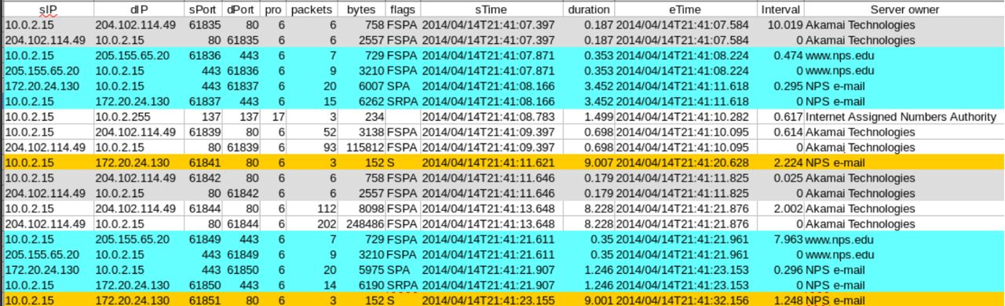
Observations
Flows generated overnight were most useful in identifying non-user generated flows. We saw:
  Repeated exchanges between the VM and servers

Slide 10
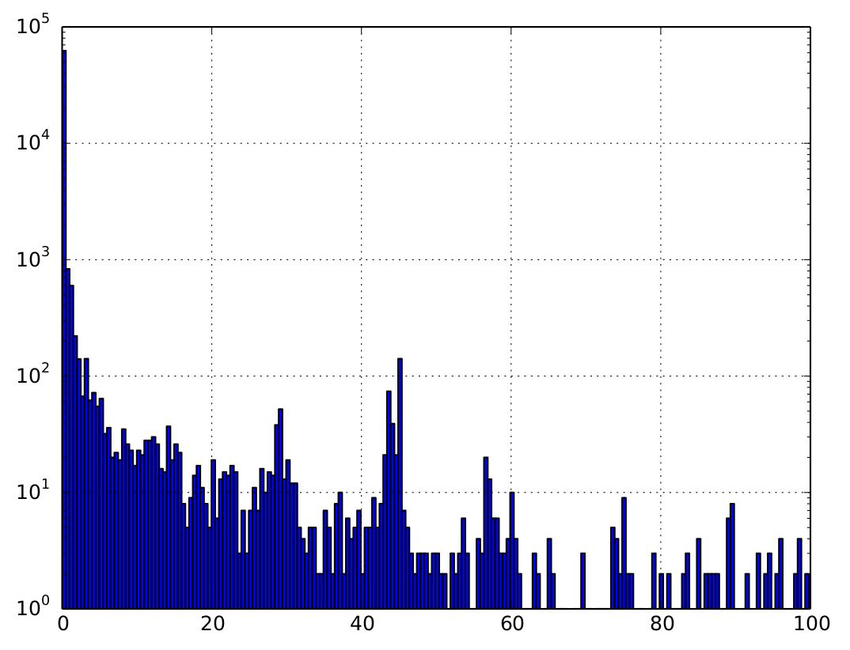
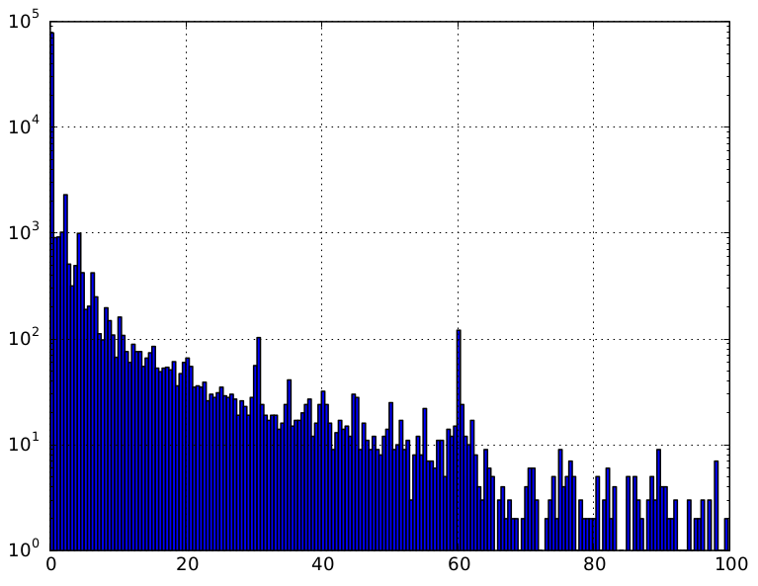
Observations (cont.)
Some inter-flow intervals were more common
Flow Count
Seconds Between Flow Starts
Seconds Between Flow Starts
Ubuntu
Windows 7

Slide 11
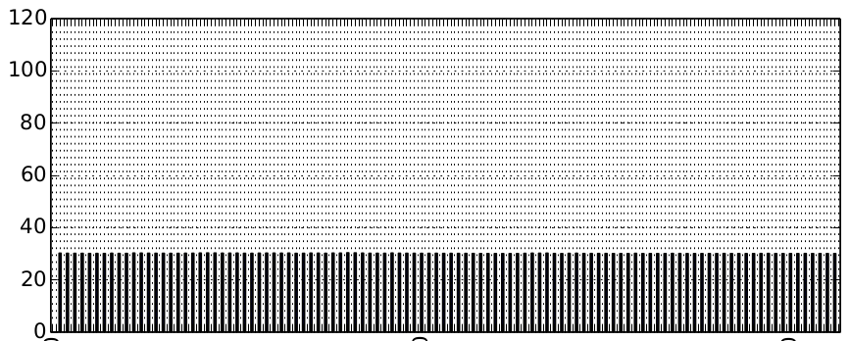
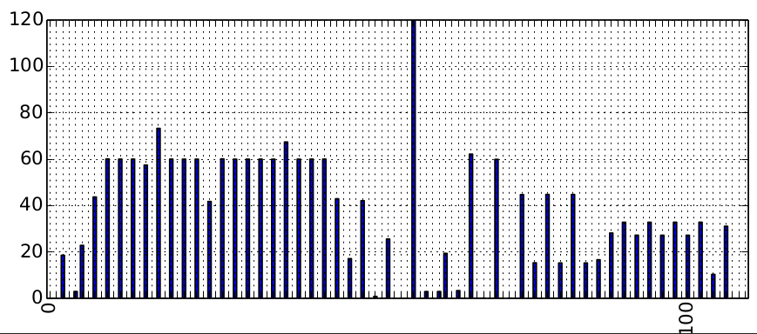
Observations (cont.)
Repeated intervals more visible when we focused on a single distant IP address, server port and protocol
Seconds Between Flow Starts
0
100
200
Flow Index
Flow Index
Dropbox LANsync, port 17500
Windows Exchange, Port 60000

Slide 12
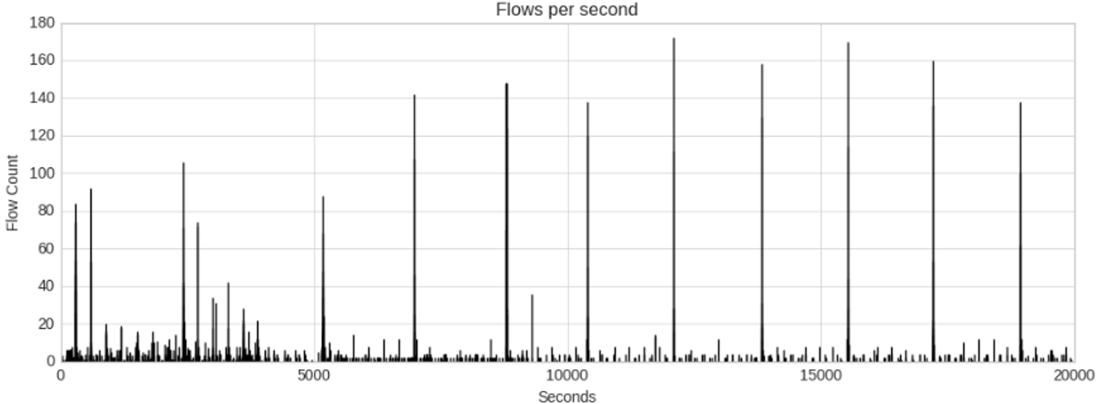
Observations (cont.)
Repeated web-page loads were observed for some web pages (e.g. CNN and Fox News)
Initial page load

Slide 13
Observations (cont.)
Labeling automatic flows in data not always straightforward
  Most inferred without examining payload data
  Browsers talk to web pages long after initial load
    A number of “keep-alive” connections continue
    Often no payload data
  Often see sequences of flows with “close” byte values
  Most defining characteristic is an increasing average interval between flow starts

Slide 14
Filtering Methods
To identify repeated behaviors, we had to identify outlier counts
  We found that the definition used by boxplots worked well
  High value outliers
    > 3rd quartile + 1.5 x IQR
Exceptions
  Less than 10 flows
    Too few to identify outliers
  Less than 10 count values
    List of counts padded to reach 10 values
    Padded values: min(min(counts)*0.1, 10)
    Captured instances of a few high count values
Outliers
1.5 IQR
3rd quartile
IQR
1st quartile

Slide 15
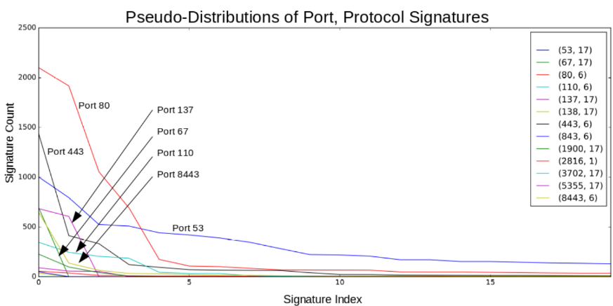
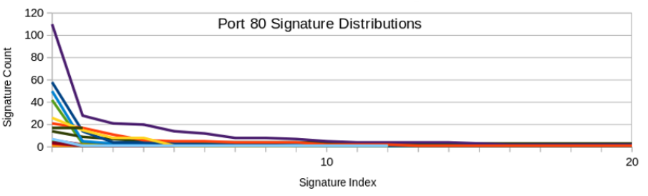
Filtering Methods:
Repeated Exchanges
Tried grouping VM flow records by shared “signatures”
  Hash of server port, protocol, outgoing packets, bytes, flags and incoming packets, bytes, flags
  Counts for traffic to/from all distant addresses
  Outlier counts were mostly TCP handshakes
We then added distant server address to grouping criteria
  Counted bidirectional flows to/from single servers
  Repeated exchanges (bi-directional flows) lined up well with flows labeled as automatic

Slide 16
Filtering Methods:
Repeated Intervals
Flows grouped based on shared distant IP address, server port, protocol, flow direction
  Intervals between flow start times rounded to nearest second
  Counted intervals > 2 seconds
  For outlier interval counts, the flows following the identified interval were counted as automatic
  CAUTION: Long flow records end at specified (active-timeout) intervals
    Usually 30 minutes

Slide 17
Filtering Methods:
Web-Page Reloads
Identifying automatic web-page reloads required:
  Identifying web-page loads
  Determine if the page loads were to the same site
    Not simple, if multiple third-party connections
  Identify loading time intervals that were “close”
    Intervals were not precise, especially when long

Slide 18
Filtering Methods:
Web-Page Reloads
Identifying web-page loads
  Flow bursts: intervals between flow starts < 4s
  Fraction of HTTP & HTTPS (80 | 443) flows in burst ≥ 0.9
  Burst size ≥ 20 flows (with packet payloads)

Slide 19



Filtering Methods:
Web-Page Reloads
Page loads are similar, if:
  Flow count difference ≤ 25%
  Distance between flow sets F₁ and F₂
    Let b(F₁[a_{i}]) = bytes to/from distant IP address a_{i}, flow set F₁
    Let b(F₁[p_{j}]) = bytes to/from distant server port p_{j}, flow set F₁
    Let m_{ip} = max(b(F₁[a_{i}]), b(F₂[a_{i}])), m_{p} = max(b(F₁[p_{j}]), b(F₂[p_{j}]))
    IP distance d_{ip} =
    Port distance d_{p} =
    D = ≤ 0.9

Slide 20

Filtering Methods:
Web-Page Reloads
Close time intervals
  Intervals were rounded
    Rounding value proportional to duration
    I = interval between web loads
      Rounding value d = Iδ (0 ≤ δ ≤ 1.0)
      d rounded to nearest multiple of 10 seconds
    I' = d

Slide 21
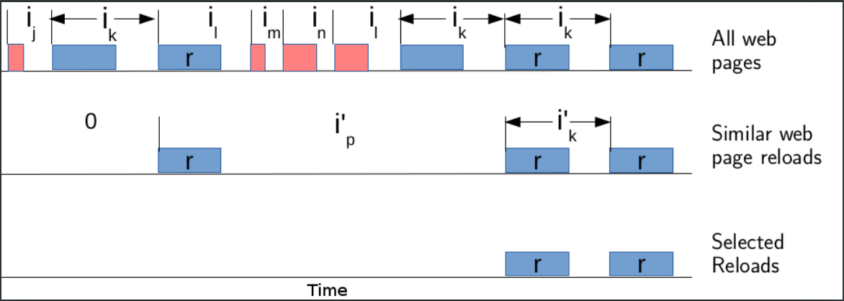
Filtering Methods:
Web-Page Reloads
Identified sequences of two or more page reloads
  Outlier count intervals (rounded) between load starts
  Page reloads after original load identified as automatic

Slide 22
Results
The signature and interval detection algorithms showed fairly good precision
  Didn’t detect all flows labeled as automatic
Virtual Machine | Algorithm | Precision | Recall | F-Score
Ubuntu | Signatures | 0.89 | 0.59 | 0.71
 | Timing | 0.96 | 0.21 | 0.34
Windows | Signatures | 0.93 | 0.50 | 0.65
 | Timing | 0.99 | 0.13 | 0.23

Slide 23
Results (cont)
Web Reload Detection
Combination of criteria:
  Timing
  Similarity
  Web page load
  String of 3 or more loads
Enabled accurate detection

Slide 24
Conclusions
The algorithms did fairly well, but didn’t detect all flows labeled as automatic
  Could be labeling issue (in part), due to classification criteria and some ambiguity in whether flows were truly automatic
Detection needs to be performed below proxies/NAT’ing
Approach could be leveraged to carve out flow sets
  Malware generated traffic could be considered automatic

